Slide 1
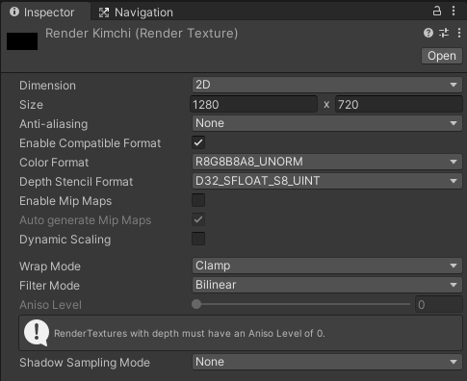
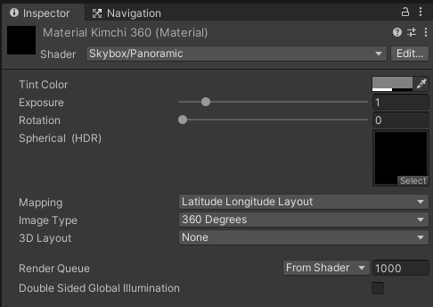
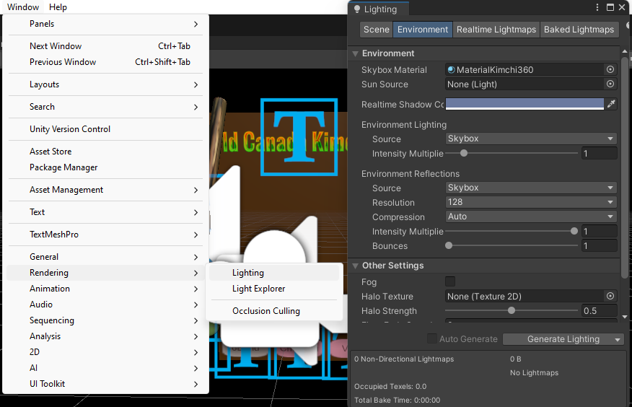
Video resolution
Add created texture
Create skybox material
Create Render Texture for skybox
Add created material
Window => Rendering => Lighting => Environment

Slide 2
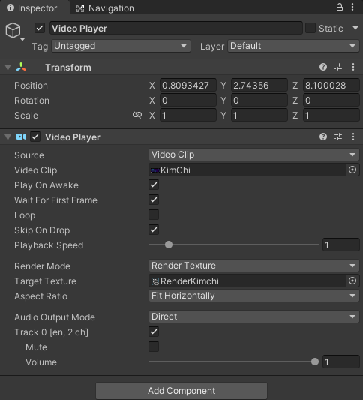
Create new video player at hierarchy window
Add video clip
Add created render texture

Slide 3
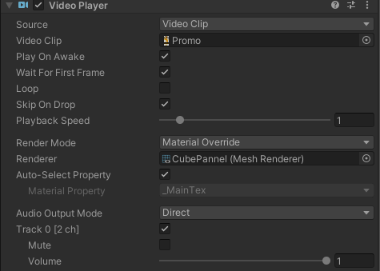
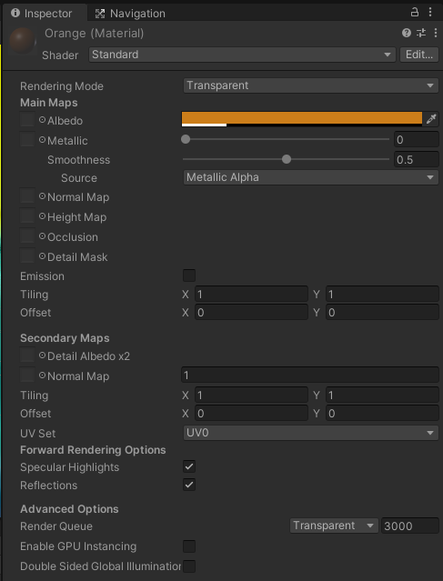
Transparent setup
Create 3D cube => Drag and drop video clip
Add material to 3D cube for controlling color and shading

Slide 4
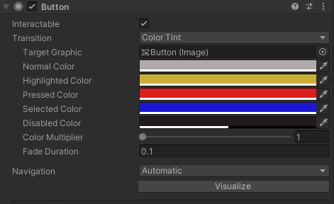
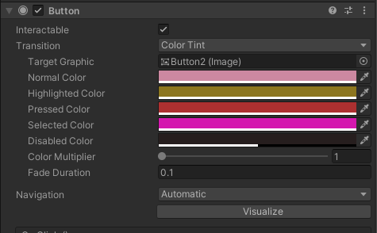
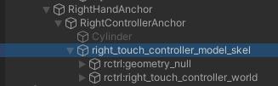
Button colors for male singer
Button colors for female singer

Slide 5
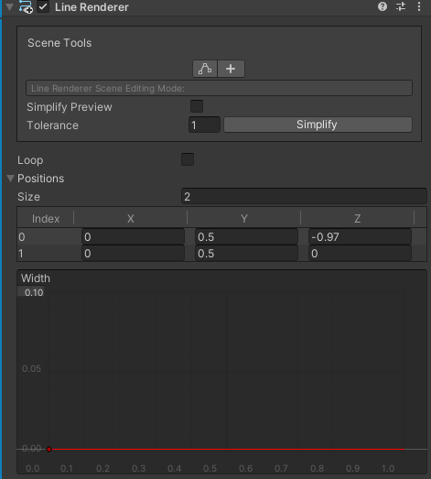
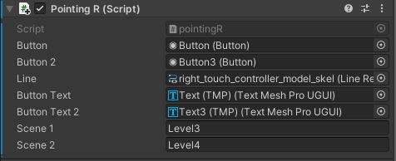
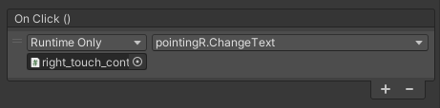
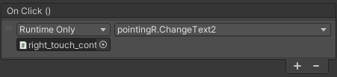
for 6band
for Viviz
Button => Change Text(TMP) to ‘Clicked’ => Scene ‘Level3’
Button3 => Change Text3(TMP) to ‘Clicked’ => Scene ‘Level4’
Determine ray width
Script was attached at Appendix A
Run Text if 6band was shot
Run Text2 if Viviz was shot

Slide 6
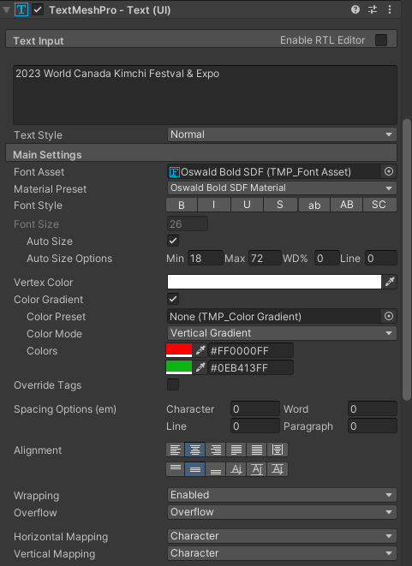
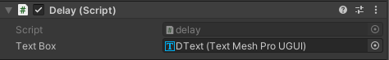
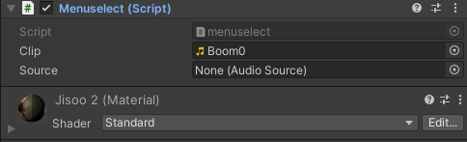
Initialize text
Font size changes dynamically
Add delays to words and phrases
Use gradation for text color

Slide 7
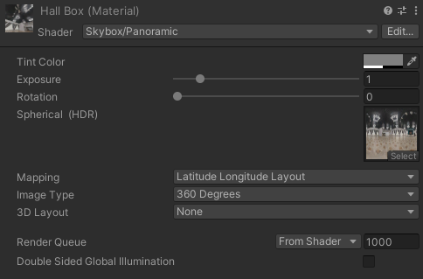
Drag and drop
to Scene background
Add concert hall image

Slide 8
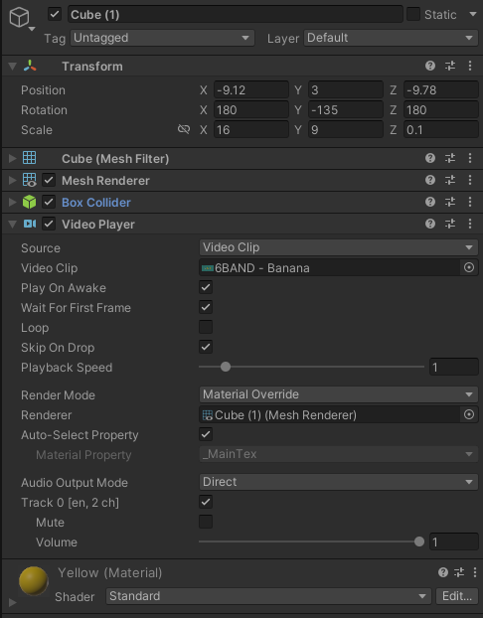
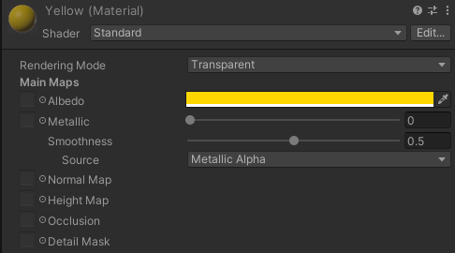
Positioning
Add music video
Screen color

Slide 9
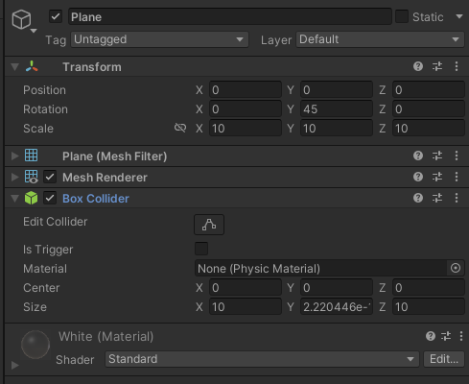
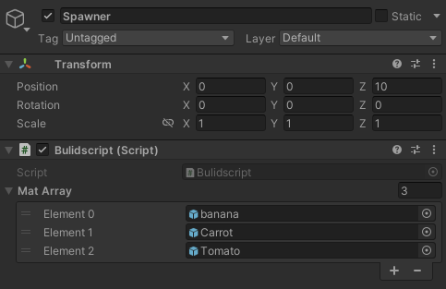
Add box collider to make falling objects stop
Add transparent color to the plane
Add script to spawn fruits
Add fruits to be spawned

Slide 10
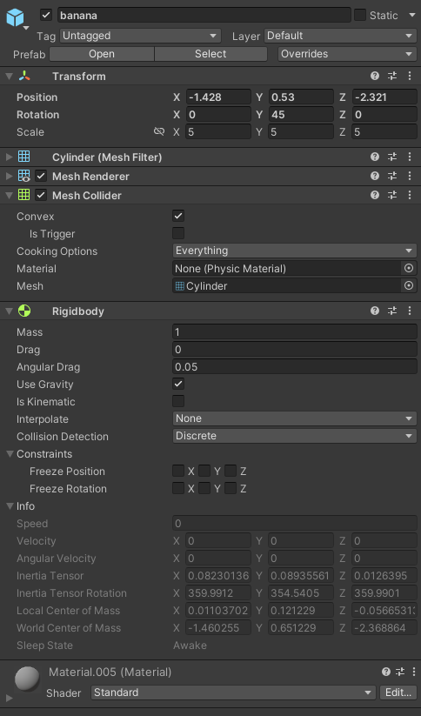
Add collider
Add rigidbody and turn on Gravity, so it falls
Keep Collision Detection as Discrete.
It makes small material pass through the floor sometimes.

Slide 11
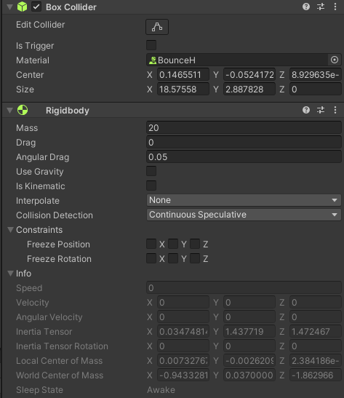
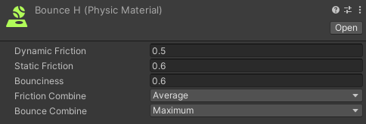
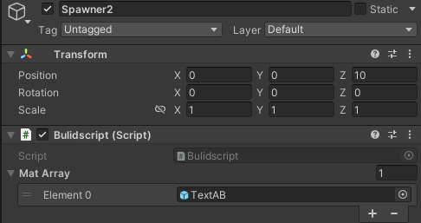
Add Bounce H to text
Add Rigidbody to text for making hittable text
Reuse Buildscript.cs for spawning
Use ‘B A N A N A’ for Element0

Slide 12
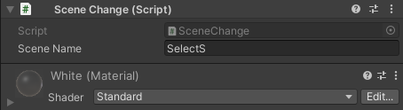
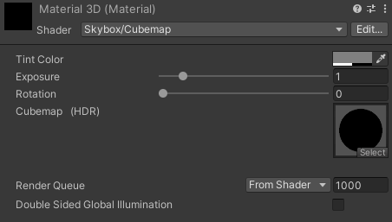
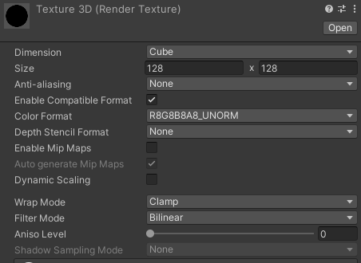
Add script for back to menu
If the block hit by ‘stick’, go back to menu
Add transparent color to the block
Add this Material to Lightening => Environment => Skybox Material

Slide 13
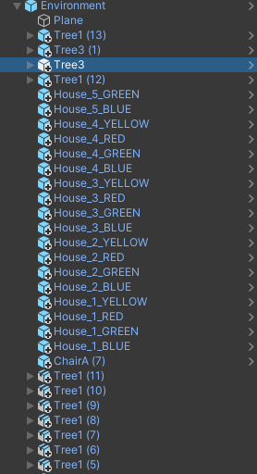
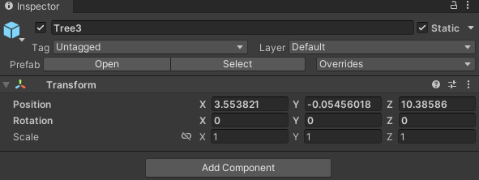
Marking as Static, so they become part of environment
Make sure all objects are under environment

Slide 14
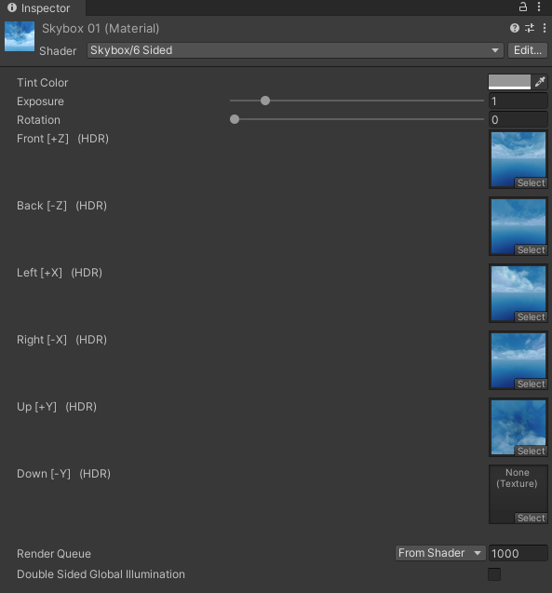
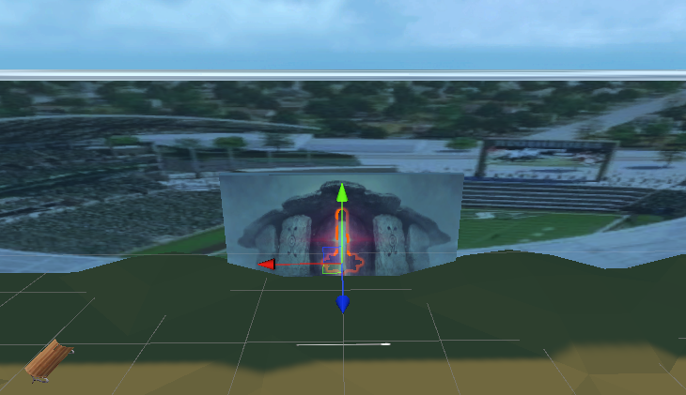
6 side images for skybox

Slide 15
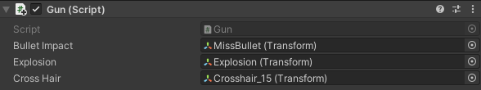
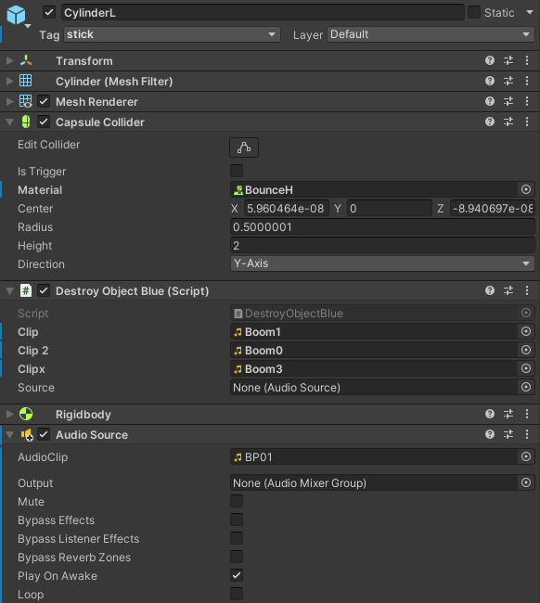
Add scripts for gun effect
Bullet reflections
Explosion by shot
Add crosshair
Make bounce when hitting objects
Add sounds when hitting enemies and menu
Add background music for game

Slide 16
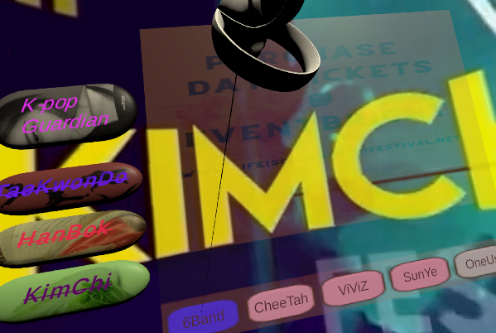
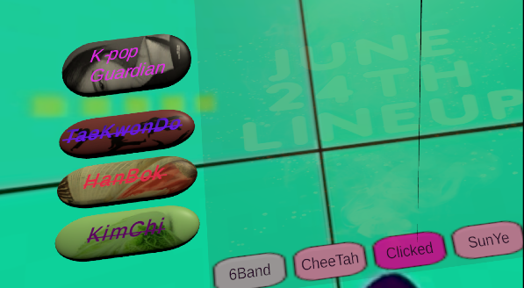

Slide 17
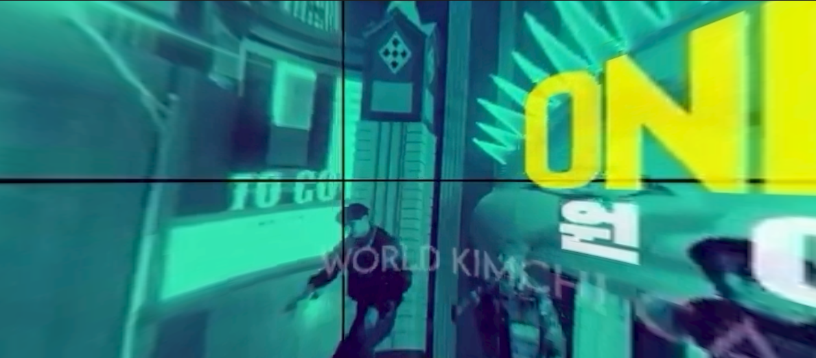
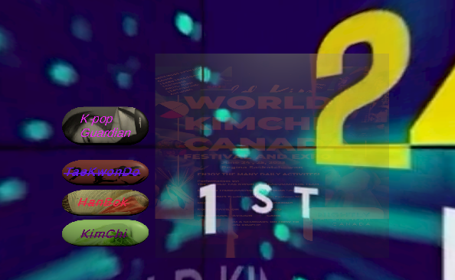
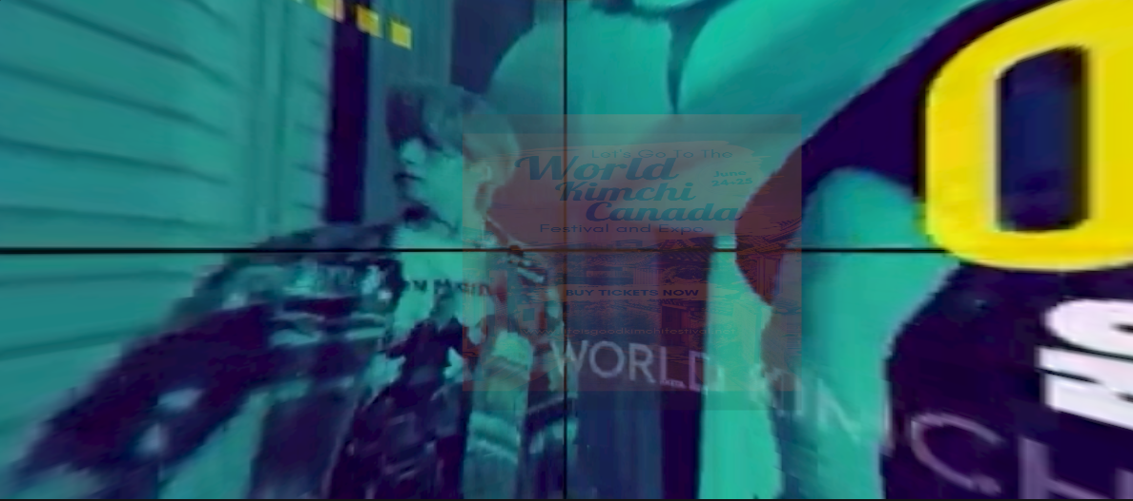

Slide 18
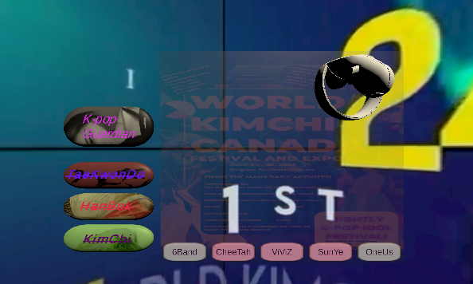



Slide 19
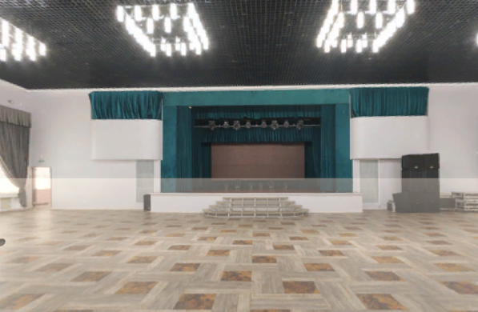
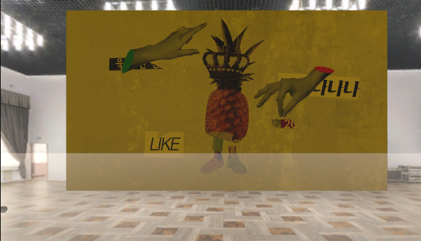

Slide 20
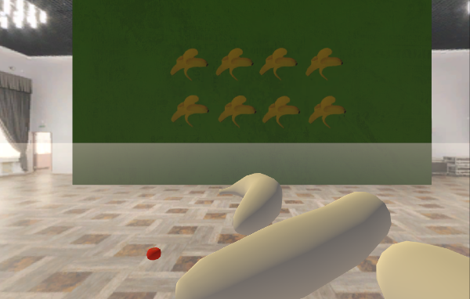
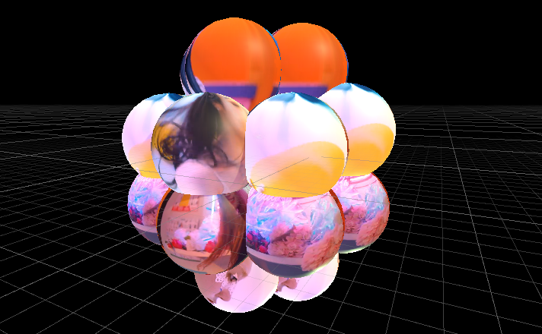
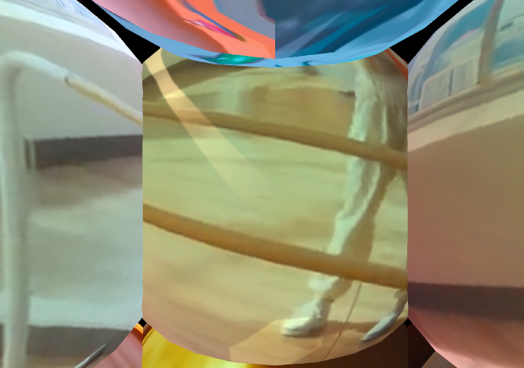
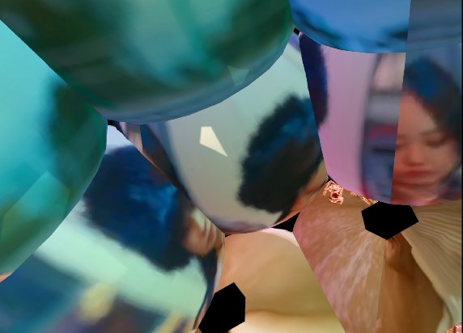

Slide 21
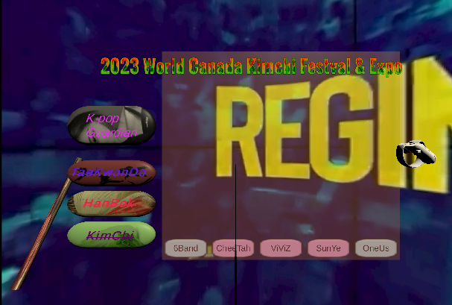
Mini Game Menu
Hit
shoot
Exhibition Hall Menu

Slide 22
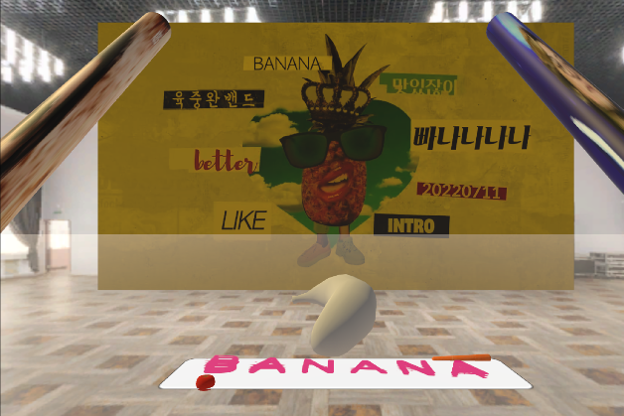
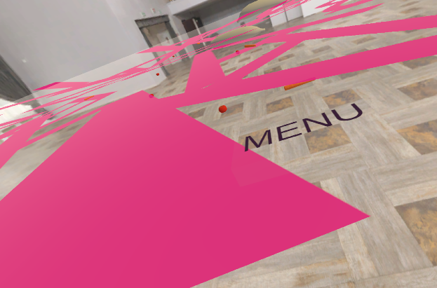

Slide 23
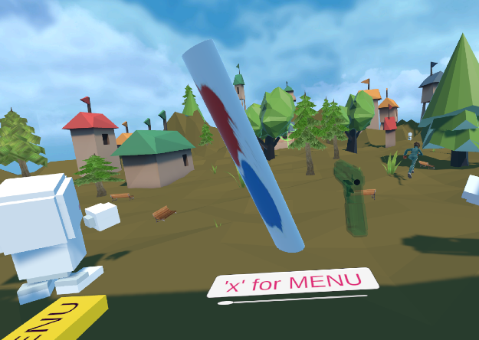

Stick
Gun

Slide 24






